Slide 1
Classifying NYC Venues Based On Traffic Data
Steffen.janssen@gmail.com

Slide 2
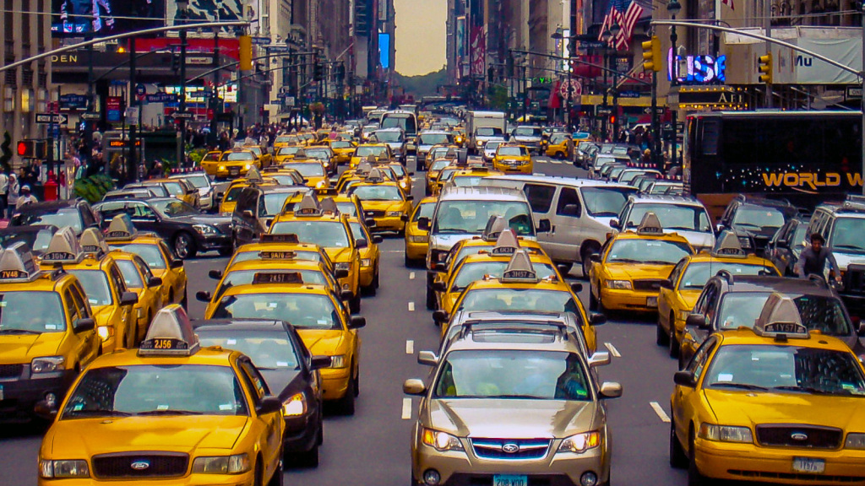
NYC Traffic flow is among the worst in the world
“$100 Billion Cost of Traffic Congestion in New York”
http://pfnyc.org/wp-content/uploads/2018/01/2018-01-Congestion-Pricing.pdf

Slide 3
Understanding traffic flows is valuable for city planning
We can start to identify correlations and determine what types of businesses are located near high-traffic areas
Better understanding of the problem is a first step in determining what stakeholders have a role to play in improving traffic
NYC government and Business owners want to understand the baseline traffic situation and identify where traffic is coming from and where it is going to.

Slide 4
Data Acquisition
NYC Traffic Data
Foursquare
This data contains 'real-time' traffic information from locations where NYCDOT picks up sensor feeds within the five boroughs of NYC, mostly on major arterials and highways.
Traffic Data: https://data.cityofnewyork.us/Transportation/Real-Time-Traffic-Speed-Data/qkm5-nuaq
Road segments: https://www.kaggle.com/crailtap/nyc-real-time-traffic-speed-data-feed#linkinfo.csv
Location: An object containing none, some, or all of address (street address), crossStreet, city, state, postalCode, country, lat, lng, and distance. All fields are strings, except for lat, lng, and distance. Distance is measured in meters.
Category: An array, possibly empty, of categories that have been applied to this venue. One of the categories will have a primary field indicating that it is the primary category for the venue.
https://api.foursquare.com/v2/venues/explore?&client_id={}&client_secret={}&v={}&ll={},{}&radius={}&limit={}

Slide 5
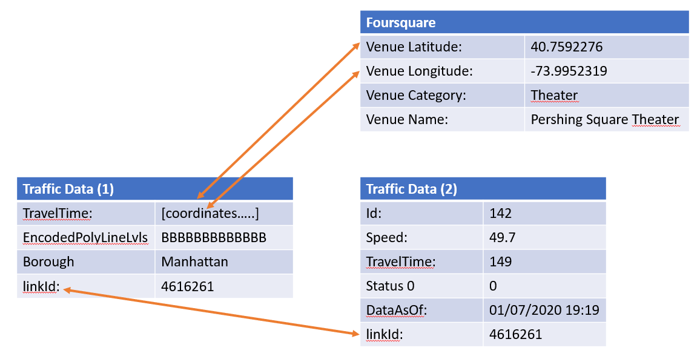
Data Mapping and preprocessing
Mapping between features
Preprocessing Traffic Data
["TRANSCOM_ID", "LINK_NAME"] columns were dropped because they do not contain data we can use.
“ENCODED_POLY_LINE_LVLS “is an encoded value for the length of the road segment, this is converted to an integer for easy processing.
“LINK_POINTS” is split up into individual featues for each coordinate of the road segment. The original is a chain of coordinates (longitude and latitude), this is split up into individual tuples for each coordinate for easy access.
“DATA_AS_OF” value is harmonized across the different measurements. Different link segments submit date information in different formats. This needs converting to a universal format that is consistent.

Slide 6
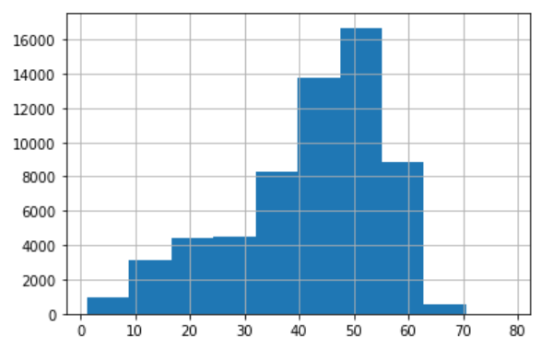
Methodology
Activites
Exploratory analysis shows traffic speeds are usually below 50 mph
Extract data
Cleanse and pre-process Data
Combine Traffic Data (1) and Traffic Data (2) by matching on the LINK_ID
Create a baseline by writing a function to score “traffic speed performance”
Use the baseline function against an average of the dataset for each of the time periods and road segments to score that date/time/segment using road speed
Build a classifier against the date/time/segments (X features) in order to predict the performance (y value)
Classify Venue locations using classifier
Analyse results

Slide 7
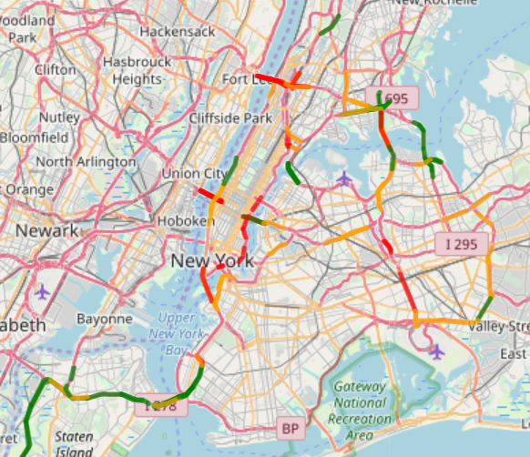
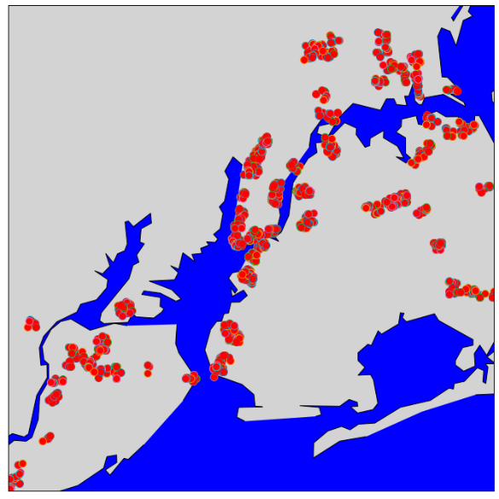
Traffic flow in 2020 and Venue Analysis
The Venues in the dataset track the road segment outlines, due to the fact that the Foursquare Data was only scraped for coordinates near the road segmentss
The Venues in the dataset track the road segment outlines, due to the fact that the Foursquare Data was only scraped for coordinates near the road segmentss
By creating a baseline we can score traffic data against the normal average. Thereby showing when traffic is worse than usual.

Slide 8
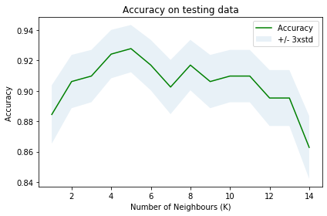
90% of coordinates are matched to their class (high, medium, low traffic speed)
But the data in the dataset is limited considering the size of New York and all the different roads for which we do not have data.
Also the Venue Categories could be grouped into parent categories to be able to do future analyses.

Slide 9
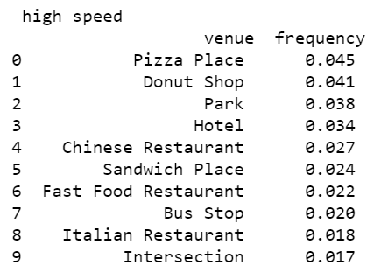
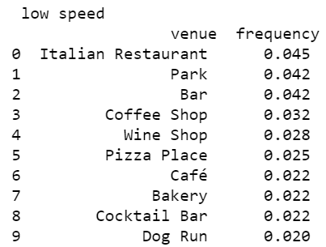
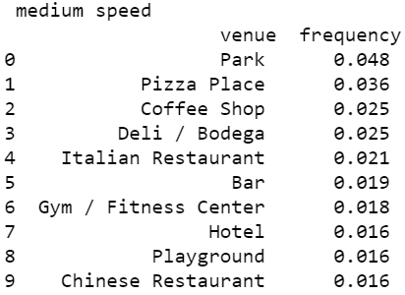
Classifying Venues using traffic data & Conclusion
Clustering areas by traffic speed shows certain venues tend to high, medium or low speed traffic areas.
Parks are the most common venue type in New York.
Fast food joints typically are located in areas with fast moving traffic.
Small and upscale restaurants are more likely to operate out of areas where traffic is slower.

